Slide 1

AWS BlackBelt Capstone Bank Fraud
Matthew Korn

Slide 2

Project Scope
Every day there are millions of transactions occurring throughout the United States and typically most of those transactions are valid. Only a handful are fraudulent. This creates a difficult task for any business to properly identify fraudulent transactions and stop them before they are processed.
However, the scope of this concept has the ability to any unwanted outcome that is part of an imbalanced dataset . i.e. Spam vs non-spam emails/test messages.
I chose this use case as the request in the project was to leverage the XGBoost model, Linear Learner (logistic regression) and KNN Means and I wanted to confirm my hypothesis that the Xgboost model is the most robust at classification models especially when compared to a Linear Learner. Also coming from a finance background I had a pre-knowledge of the business use-case.
The data set was from a Kaggle webpage (https://www.kaggle.com/ntnu-testimon/paysim1) , it leverages simulated data as real-world data is often very sensitive to privacy compliance and not publicly available. The data was provided in a csv form.
To simulate the concept of actual transactions we approach the ingestion data by reading in the csv file on an EC2 – Server line line through a kinesis stream. This helped create many batches of results as we would see in a real-world setting.
Notes:
A completely managed service; you operate in a dynamic, on-demand mode, with all of the flexibility, agility and scalability of cloud based infrastructure. Presidio ensures RI’s are applied to running instances 100% of the time eliminating waste and maximizing cost reduction.
Eliminates the time and operational overhead associated with usage and RI forecasting, RI type and term analysis, technical risk management, and financial risk and ROI analysis.
Presidio redistributes any/all unused/under-utilized RI’s through our framework, eliminating your burden of selling on the AWS marketplace, tracking transactions, distributing internal credits and associated management.
Enhanced and Customized Billing/Performance optimization reporting
Access to Presidio/AWS Solution Architects
Presidio will provide full access to all reporting data via CloudHealth

Slide 3
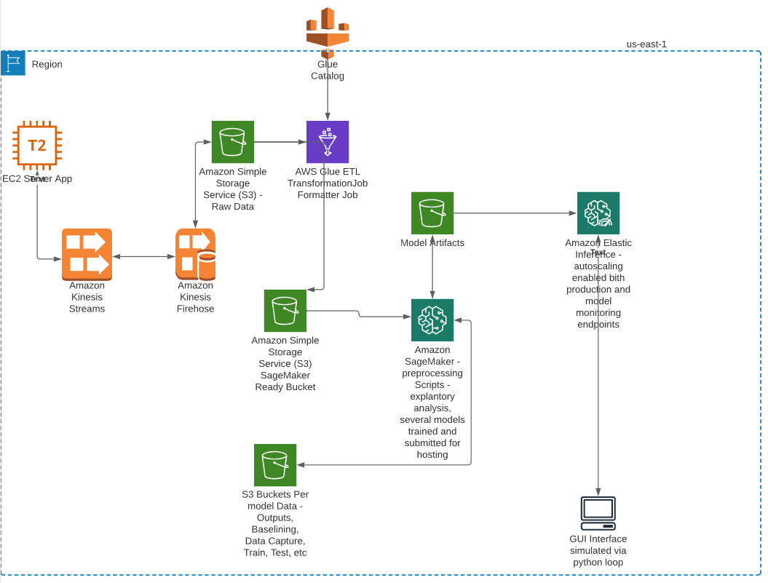
Project Architecture
Notes:
A completely managed service; you operate in a dynamic, on-demand mode, with all of the flexibility, agility and scalability of cloud based infrastructure. Presidio ensures RI’s are applied to running instances 100% of the time eliminating waste and maximizing cost reduction.
Eliminates the time and operational overhead associated with usage and RI forecasting, RI type and term analysis, technical risk management, and financial risk and ROI analysis.
Presidio redistributes any/all unused/under-utilized RI’s through our framework, eliminating your burden of selling on the AWS marketplace, tracking transactions, distributing internal credits and associated management.
Enhanced and Customized Billing/Performance optimization reporting
Access to Presidio/AWS Solution Architects
Presidio will provide full access to all reporting data via CloudHealth

Slide 4
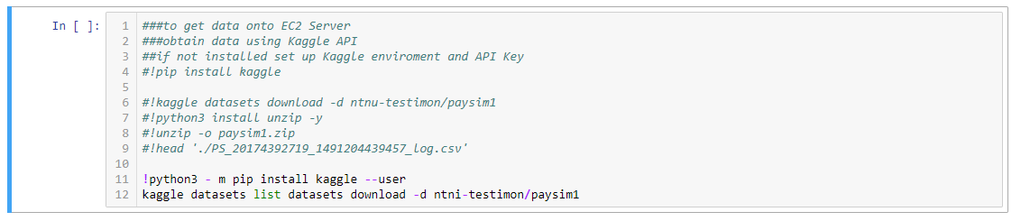
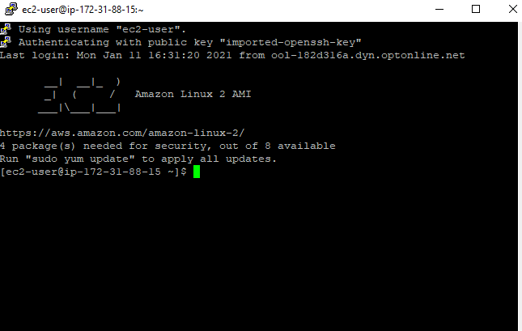
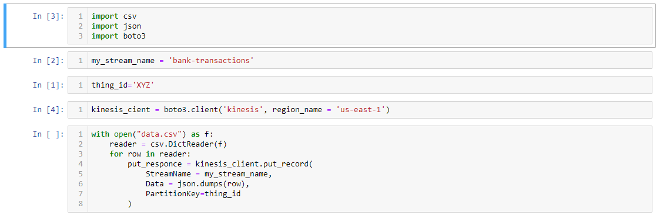
EC2 Server
A T2-Micro SSH Via Putty – set up to collect Data
Set up aws config, installed kinesis client, pip installed Kaggle API
Ran Kaggle datasets function
Started kinesis stream – reading in csv file line-by-line
Notes:
A completely managed service; you operate in a dynamic, on-demand mode, with all of the flexibility, agility and scalability of cloud based infrastructure. Presidio ensures RI’s are applied to running instances 100% of the time eliminating waste and maximizing cost reduction.
Eliminates the time and operational overhead associated with usage and RI forecasting, RI type and term analysis, technical risk management, and financial risk and ROI analysis.
Presidio redistributes any/all unused/under-utilized RI’s through our framework, eliminating your burden of selling on the AWS marketplace, tracking transactions, distributing internal credits and associated management.
Enhanced and Customized Billing/Performance optimization reporting
Access to Presidio/AWS Solution Architects
Presidio will provide full access to all reporting data via CloudHealth

Slide 5
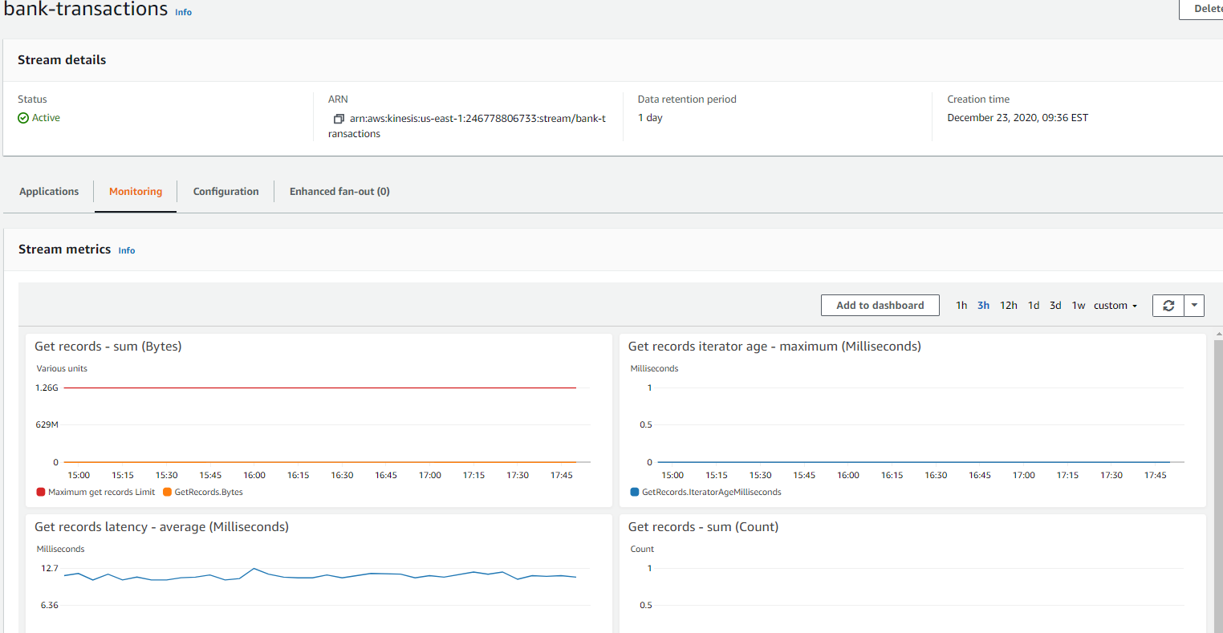
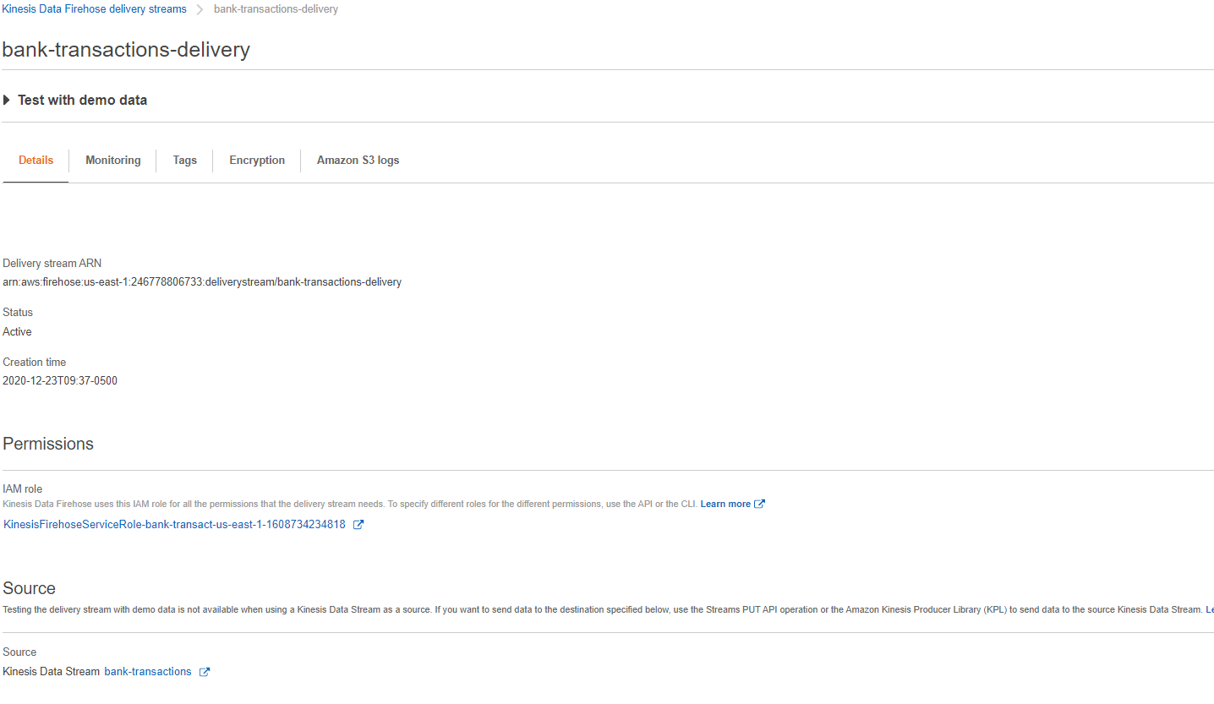
Kinesis Stream and Kinesis Firehose
Kinesis Stream – ingest “live” data
Kinesis Firehose – Send streaming data to S3
Notes:
A completely managed service; you operate in a dynamic, on-demand mode, with all of the flexibility, agility and scalability of cloud based infrastructure. Presidio ensures RI’s are applied to running instances 100% of the time eliminating waste and maximizing cost reduction.
Eliminates the time and operational overhead associated with usage and RI forecasting, RI type and term analysis, technical risk management, and financial risk and ROI analysis.
Presidio redistributes any/all unused/under-utilized RI’s through our framework, eliminating your burden of selling on the AWS marketplace, tracking transactions, distributing internal credits and associated management.
Enhanced and Customized Billing/Performance optimization reporting
Access to Presidio/AWS Solution Architects
Presidio will provide full access to all reporting data via CloudHealth

Slide 6
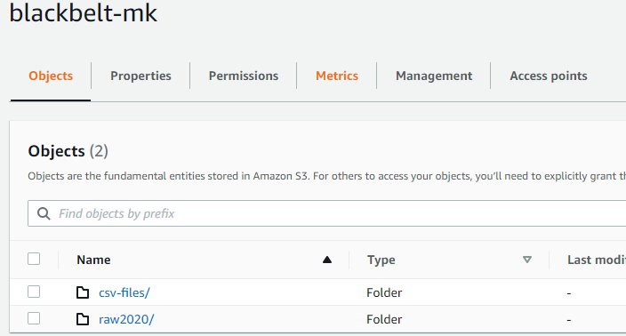
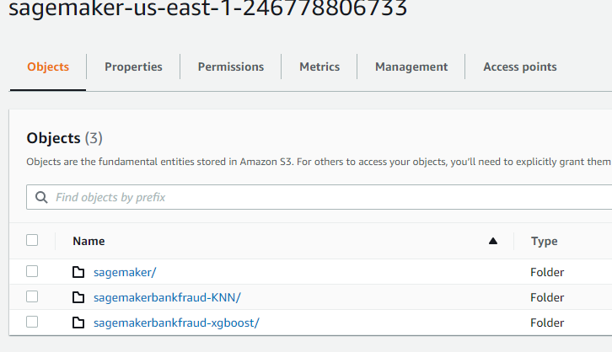
S3 – Data Lake
Bucket for Stream and Glue Conversion
SageMaker Model Buckets
Notes:
A completely managed service; you operate in a dynamic, on-demand mode, with all of the flexibility, agility and scalability of cloud based infrastructure. Presidio ensures RI’s are applied to running instances 100% of the time eliminating waste and maximizing cost reduction.
Eliminates the time and operational overhead associated with usage and RI forecasting, RI type and term analysis, technical risk management, and financial risk and ROI analysis.
Presidio redistributes any/all unused/under-utilized RI’s through our framework, eliminating your burden of selling on the AWS marketplace, tracking transactions, distributing internal credits and associated management.
Enhanced and Customized Billing/Performance optimization reporting
Access to Presidio/AWS Solution Architects
Presidio will provide full access to all reporting data via CloudHealth

Slide 7
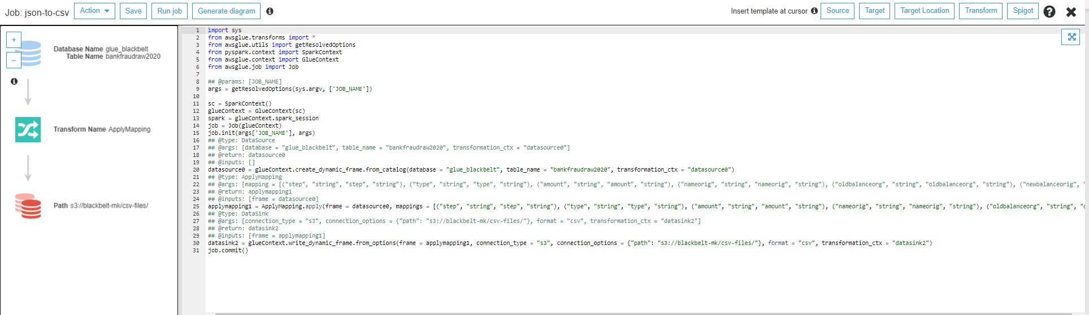
Glue – Json to csv transformation
Glue Job created to transform json object firehose delivery to csv to help get the data to its original state from Kaggle – also pandas dataframes are easier to work with csv files
Notes:
A completely managed service; you operate in a dynamic, on-demand mode, with all of the flexibility, agility and scalability of cloud based infrastructure. Presidio ensures RI’s are applied to running instances 100% of the time eliminating waste and maximizing cost reduction.
Eliminates the time and operational overhead associated with usage and RI forecasting, RI type and term analysis, technical risk management, and financial risk and ROI analysis.
Presidio redistributes any/all unused/under-utilized RI’s through our framework, eliminating your burden of selling on the AWS marketplace, tracking transactions, distributing internal credits and associated management.
Enhanced and Customized Billing/Performance optimization reporting
Access to Presidio/AWS Solution Architects
Presidio will provide full access to all reporting data via CloudHealth

Slide 8
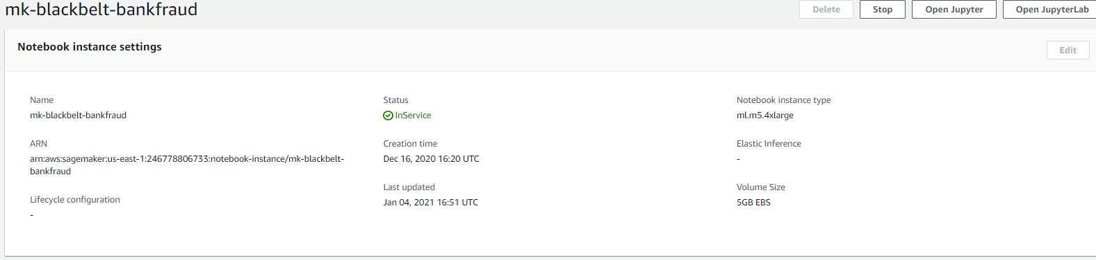
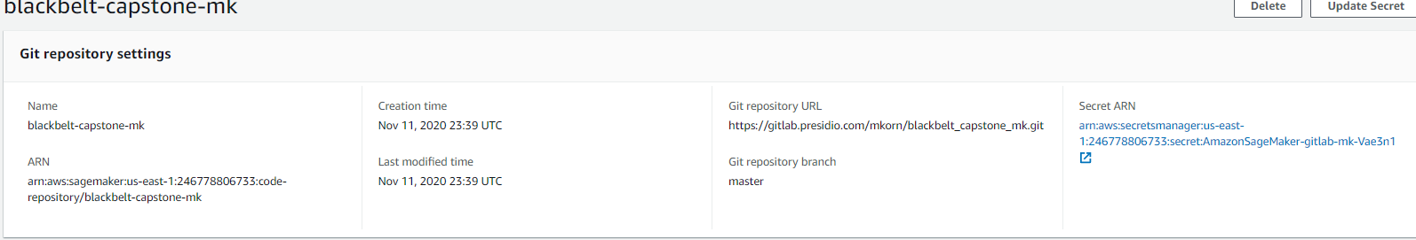
SageMaker Notebook
Hosted a m5.4xlarge notebook instance and pre-setup linkage to git repo
Notes:
A completely managed service; you operate in a dynamic, on-demand mode, with all of the flexibility, agility and scalability of cloud based infrastructure. Presidio ensures RI’s are applied to running instances 100% of the time eliminating waste and maximizing cost reduction.
Eliminates the time and operational overhead associated with usage and RI forecasting, RI type and term analysis, technical risk management, and financial risk and ROI analysis.
Presidio redistributes any/all unused/under-utilized RI’s through our framework, eliminating your burden of selling on the AWS marketplace, tracking transactions, distributing internal credits and associated management.
Enhanced and Customized Billing/Performance optimization reporting
Access to Presidio/AWS Solution Architects
Presidio will provide full access to all reporting data via CloudHealth

Slide 9
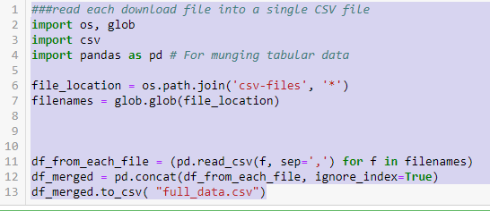
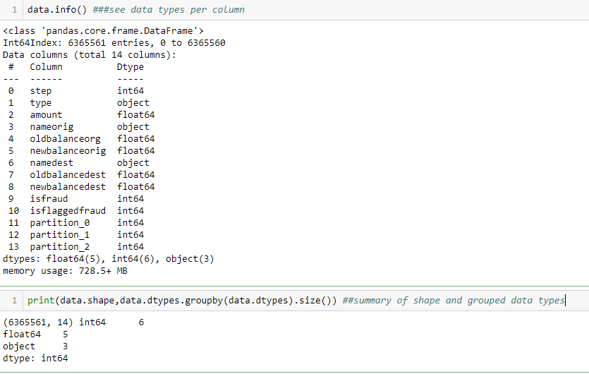
SageMaker Jupyter Notebook – Exp. Analysis and Pre.
The Explanatory Analysis and Preprocessing Notebook was used for data exploration and transformation: here is what was done and found:
Read in all data and merged into one file
Data Variables – 6.36MM transactions and 11 original features
Step – considered 1 unit of time (hour) of a day
Type – categorical type of transaction (for example Transfer)
Amount – total of transaction
Nameorig – originating account
Oldbalanceorig – balances before transaction in origin account
Newbalanceorig – new balance after transaction
Namedest – destination account
Oldbalancedest - balances before transaction in destination account
Newbalancedest – new balance desitination account
Isfraud – target variable fraudulently identified transactions
Isflaggedfraud – business model that flags only large transactions
Partition(0,1,2) – data created by glue (will drop)
Notes:
A completely managed service; you operate in a dynamic, on-demand mode, with all of the flexibility, agility and scalability of cloud based infrastructure. Presidio ensures RI’s are applied to running instances 100% of the time eliminating waste and maximizing cost reduction.
Eliminates the time and operational overhead associated with usage and RI forecasting, RI type and term analysis, technical risk management, and financial risk and ROI analysis.
Presidio redistributes any/all unused/under-utilized RI’s through our framework, eliminating your burden of selling on the AWS marketplace, tracking transactions, distributing internal credits and associated management.
Enhanced and Customized Billing/Performance optimization reporting
Access to Presidio/AWS Solution Architects
Presidio will provide full access to all reporting data via CloudHealth

Slide 10
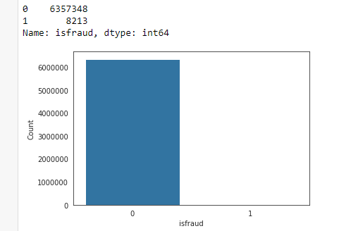
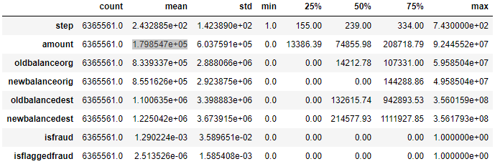
Explanatory Analysis/Preprocessing Continued
Steps to review data and clean:
Step 1 – reviewed any missing data and if any dropped rows with missing data.
Step 2 - dropped partition columns (as they were glue generated and artificial data)
Step 3 – ran summary statistics to understand ranges of data – average transaction size was $179K
Step 4 - Ran plot to show number of fraud vs non-fraud items in dataset – clearly shows imbalanced dataset
Notes:
A completely managed service; you operate in a dynamic, on-demand mode, with all of the flexibility, agility and scalability of cloud based infrastructure. Presidio ensures RI’s are applied to running instances 100% of the time eliminating waste and maximizing cost reduction.
Eliminates the time and operational overhead associated with usage and RI forecasting, RI type and term analysis, technical risk management, and financial risk and ROI analysis.
Presidio redistributes any/all unused/under-utilized RI’s through our framework, eliminating your burden of selling on the AWS marketplace, tracking transactions, distributing internal credits and associated management.
Enhanced and Customized Billing/Performance optimization reporting
Access to Presidio/AWS Solution Architects
Presidio will provide full access to all reporting data via CloudHealth

Slide 11
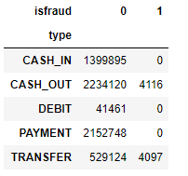
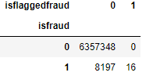
Explanatory Analysis/Preprocessing Continued
Step 5 – ran additional cross-tabulation tables
Interesting find – Cash_Out and Transfer transactions are only where fraud is identified – will one-hot including to focus on those two transation types
Immateriale flagged isflaggedfraud items – we will drop this variable
Notes:
A completely managed service; you operate in a dynamic, on-demand mode, with all of the flexibility, agility and scalability of cloud based infrastructure. Presidio ensures RI’s are applied to running instances 100% of the time eliminating waste and maximizing cost reduction.
Eliminates the time and operational overhead associated with usage and RI forecasting, RI type and term analysis, technical risk management, and financial risk and ROI analysis.
Presidio redistributes any/all unused/under-utilized RI’s through our framework, eliminating your burden of selling on the AWS marketplace, tracking transactions, distributing internal credits and associated management.
Enhanced and Customized Billing/Performance optimization reporting
Access to Presidio/AWS Solution Architects
Presidio will provide full access to all reporting data via CloudHealth

Slide 12
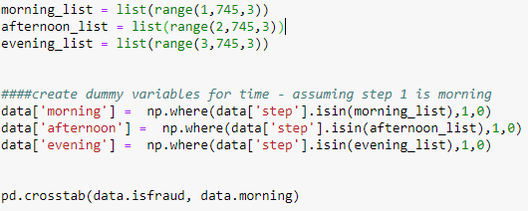
Explanatory Analysis/Preprocessing Continued
Step 6 – feature engineering on “Step” column and then additional cross tabulation
Assuming step 1 was the 1st hour of day 1 we created lists to separate the data by every 8th our of day and generate a variable for morning (hours 1-8 of any day , i.e step 25 is hour 1 of day 2) and so on.
What was discovered was there was a relatively equal amount of frandulent transactions per time period. 2710, 2799 and 2695 respectively for morning, afternoon and evening. However keeping variables to understand if there is a pattern that a simple crosstabulation cannot see.
Notes:
A completely managed service; you operate in a dynamic, on-demand mode, with all of the flexibility, agility and scalability of cloud based infrastructure. Presidio ensures RI’s are applied to running instances 100% of the time eliminating waste and maximizing cost reduction.
Eliminates the time and operational overhead associated with usage and RI forecasting, RI type and term analysis, technical risk management, and financial risk and ROI analysis.
Presidio redistributes any/all unused/under-utilized RI’s through our framework, eliminating your burden of selling on the AWS marketplace, tracking transactions, distributing internal credits and associated management.
Enhanced and Customized Billing/Performance optimization reporting
Access to Presidio/AWS Solution Architects
Presidio will provide full access to all reporting data via CloudHealth

Slide 13
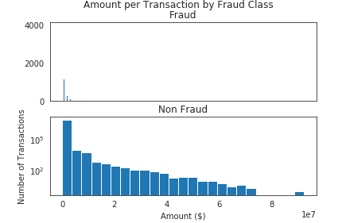
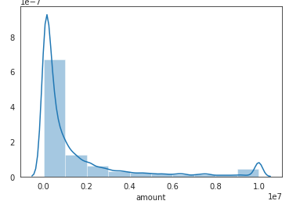
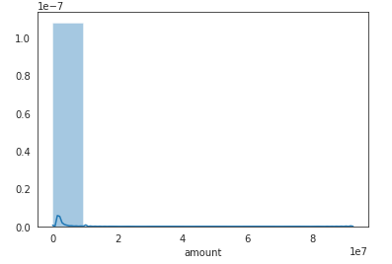
Explanatory Analysis/Preprocessing Continued
Step 7 – additional visualizations
Average Transaction Size for fraud vs non Fraud
Notes:
A completely managed service; you operate in a dynamic, on-demand mode, with all of the flexibility, agility and scalability of cloud based infrastructure. Presidio ensures RI’s are applied to running instances 100% of the time eliminating waste and maximizing cost reduction.
Eliminates the time and operational overhead associated with usage and RI forecasting, RI type and term analysis, technical risk management, and financial risk and ROI analysis.
Presidio redistributes any/all unused/under-utilized RI’s through our framework, eliminating your burden of selling on the AWS marketplace, tracking transactions, distributing internal credits and associated management.
Enhanced and Customized Billing/Performance optimization reporting
Access to Presidio/AWS Solution Architects
Presidio will provide full access to all reporting data via CloudHealth

Slide 14
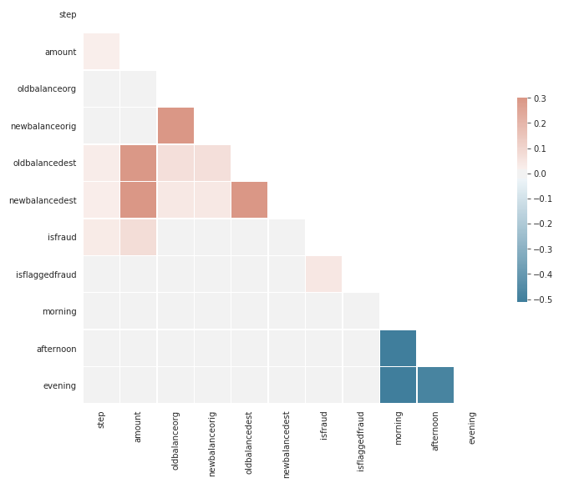
Explanatory Analysis/Preprocessing Continued
Step 7 – correlation analysis – not the strongest pearson’s r correlation – feature engineering is needed
Notes:
A completely managed service; you operate in a dynamic, on-demand mode, with all of the flexibility, agility and scalability of cloud based infrastructure. Presidio ensures RI’s are applied to running instances 100% of the time eliminating waste and maximizing cost reduction.
Eliminates the time and operational overhead associated with usage and RI forecasting, RI type and term analysis, technical risk management, and financial risk and ROI analysis.
Presidio redistributes any/all unused/under-utilized RI’s through our framework, eliminating your burden of selling on the AWS marketplace, tracking transactions, distributing internal credits and associated management.
Enhanced and Customized Billing/Performance optimization reporting
Access to Presidio/AWS Solution Architects
Presidio will provide full access to all reporting data via CloudHealth

Slide 15
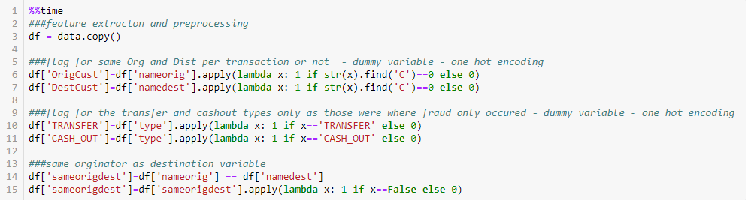
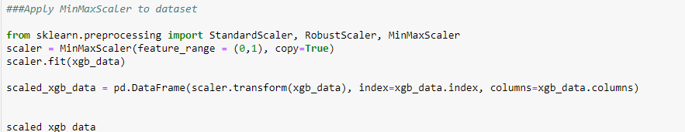
Explanatory Analysis/Preprocessing Continued
Step 8 – create new variables and drop some and finally scale data with min/max scaler (data sent to S3 as final step
Flags to check if any origin and destination accounts are the same in any transaction
One hot encoding for Transfer and Cash Out types
Discrepancies Difference – Original balance +/- transaction = Ending balance or not.
Dropped unneeded variables -> droplist=['isflaggedfraud', 'type','namedest','nameorig', 'sameorigdest’]
Notes:
A completely managed service; you operate in a dynamic, on-demand mode, with all of the flexibility, agility and scalability of cloud based infrastructure. Presidio ensures RI’s are applied to running instances 100% of the time eliminating waste and maximizing cost reduction.
Eliminates the time and operational overhead associated with usage and RI forecasting, RI type and term analysis, technical risk management, and financial risk and ROI analysis.
Presidio redistributes any/all unused/under-utilized RI’s through our framework, eliminating your burden of selling on the AWS marketplace, tracking transactions, distributing internal credits and associated management.
Enhanced and Customized Billing/Performance optimization reporting
Access to Presidio/AWS Solution Architects
Presidio will provide full access to all reporting data via CloudHealth

Slide 16
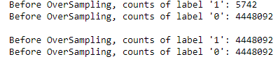
Model Creation
Due to the imbalanced nature of the data and adjustment is required to balance the data – SMOTE was leveraged under the imblearn package – it was only applied to the training dataset.
All Data was split into Training, Validation and Testing – 70%, 20%, 10%
Training set – SMOTE Applied to balance data
CSV files were created for training without header, validation , training with header and test with header
All CSV files uploaded to corresponding S3 sub-directories per each model
Three Models used
XGBoost
Linear Learner
KNN
Consistent Development Steps
All Models created with training and validation Data
All Models were tuned using sagemaker tuner (best model was used for production)
All Models were hosted on an autoscaling policy
All models invoked with a sample of the test via a looping stream of a csv file
Notes:
A completely managed service; you operate in a dynamic, on-demand mode, with all of the flexibility, agility and scalability of cloud based infrastructure. Presidio ensures RI’s are applied to running instances 100% of the time eliminating waste and maximizing cost reduction.
Eliminates the time and operational overhead associated with usage and RI forecasting, RI type and term analysis, technical risk management, and financial risk and ROI analysis.
Presidio redistributes any/all unused/under-utilized RI’s through our framework, eliminating your burden of selling on the AWS marketplace, tracking transactions, distributing internal credits and associated management.
Enhanced and Customized Billing/Performance optimization reporting
Access to Presidio/AWS Solution Architects
Presidio will provide full access to all reporting data via CloudHealth

Slide 17
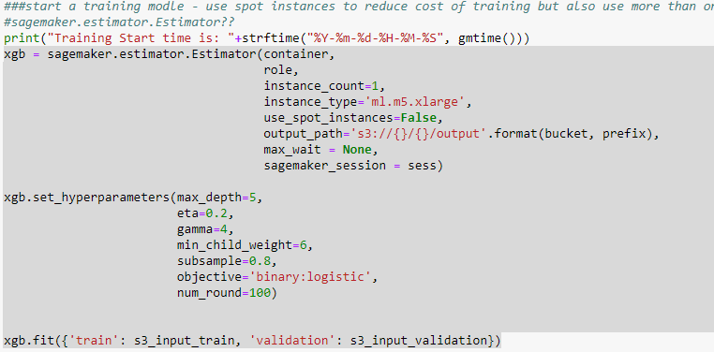
Model XGboost
Container used = 683313688378.dkr.ecr.us-east-1.amazonaws.com/sagemaker-xgboost:1.2-1
Training Job completed 536 seconds – classifion model required binary:logistic as objective
Notes:
A completely managed service; you operate in a dynamic, on-demand mode, with all of the flexibility, agility and scalability of cloud based infrastructure. Presidio ensures RI’s are applied to running instances 100% of the time eliminating waste and maximizing cost reduction.
Eliminates the time and operational overhead associated with usage and RI forecasting, RI type and term analysis, technical risk management, and financial risk and ROI analysis.
Presidio redistributes any/all unused/under-utilized RI’s through our framework, eliminating your burden of selling on the AWS marketplace, tracking transactions, distributing internal credits and associated management.
Enhanced and Customized Billing/Performance optimization reporting
Access to Presidio/AWS Solution Architects
Presidio will provide full access to all reporting data via CloudHealth

Slide 18
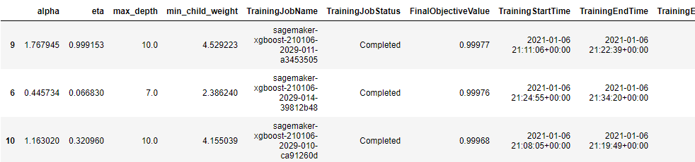
Model Xgboost - tune
Validation:auc used to tune the model – 20 Jobs
Tuned on:
Eta
Min_child_weight
Alpha
Max_depth
Best Model
Eta – 0.9991525934421017
Min_child_weight = 4.529222649514955
Alpha = 1.76794551075343697
Max_depth = 10
Best Model Name = sagemaker-xgboost-210106-2029-011-a3453505
Notes:
A completely managed service; you operate in a dynamic, on-demand mode, with all of the flexibility, agility and scalability of cloud based infrastructure. Presidio ensures RI’s are applied to running instances 100% of the time eliminating waste and maximizing cost reduction.
Eliminates the time and operational overhead associated with usage and RI forecasting, RI type and term analysis, technical risk management, and financial risk and ROI analysis.
Presidio redistributes any/all unused/under-utilized RI’s through our framework, eliminating your burden of selling on the AWS marketplace, tracking transactions, distributing internal credits and associated management.
Enhanced and Customized Billing/Performance optimization reporting
Access to Presidio/AWS Solution Architects
Presidio will provide full access to all reporting data via CloudHealth

Slide 19
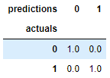
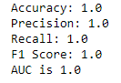
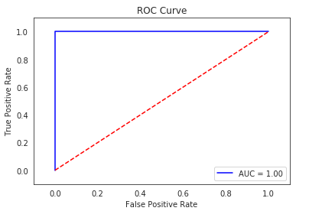
Model Xgboost – host and eval
Analysis of results used: 1000 Sample Size invoked on Endpoint
Confusion matrix
Accuracy
Precision
Recall
F1 Score
AUC
ROC Curve
Results are really good – the no errors is most likely a reflection of the sample chosen – validation accuracy on tuning model was .9997 – so we didn’t expect many misclassifications – in fact before SMOTE was applied our original matrix had a few erros.
Notes:
A completely managed service; you operate in a dynamic, on-demand mode, with all of the flexibility, agility and scalability of cloud based infrastructure. Presidio ensures RI’s are applied to running instances 100% of the time eliminating waste and maximizing cost reduction.
Eliminates the time and operational overhead associated with usage and RI forecasting, RI type and term analysis, technical risk management, and financial risk and ROI analysis.
Presidio redistributes any/all unused/under-utilized RI’s through our framework, eliminating your burden of selling on the AWS marketplace, tracking transactions, distributing internal credits and associated management.
Enhanced and Customized Billing/Performance optimization reporting
Access to Presidio/AWS Solution Architects
Presidio will provide full access to all reporting data via CloudHealth

Slide 20
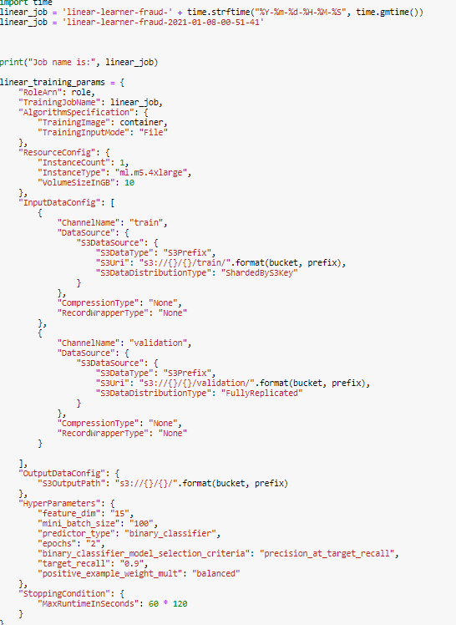
Model Linear Learner
Container used = 382416733822.dkr.ecr.us-east-1.amazonaws.com/linear-learner:1
Slightly different approach
Transformed train, test and validation sets into numpy arrays and then converted the numpy arrays into Record.IO file format
Also set up parameters separately and did not use direct estimator
Key Parameters used
Binary_classifier
Balanced (positive example weight)
Precision_at_target_recall
Training Results – Completed , CPU times: user 65.8 ms, sys: 3.61 ms, total: 69.4 ms ,Wall time: 120 ms
Notes:
A completely managed service; you operate in a dynamic, on-demand mode, with all of the flexibility, agility and scalability of cloud based infrastructure. Presidio ensures RI’s are applied to running instances 100% of the time eliminating waste and maximizing cost reduction.
Eliminates the time and operational overhead associated with usage and RI forecasting, RI type and term analysis, technical risk management, and financial risk and ROI analysis.
Presidio redistributes any/all unused/under-utilized RI’s through our framework, eliminating your burden of selling on the AWS marketplace, tracking transactions, distributing internal credits and associated management.
Enhanced and Customized Billing/Performance optimization reporting
Access to Presidio/AWS Solution Architects
Presidio will provide full access to all reporting data via CloudHealth

Slide 21
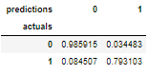
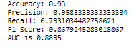
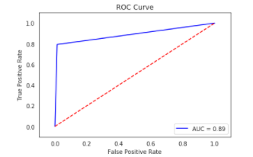
Model Linear Learner – host and eval
Analysis of results used: 100 Sample Size invoked on Endpoint – had to convert data correctly first
Confusion matrix
Accuracy
Precision
Recall
F1 Score
AUC
ROC Curve
Model performs well at 93% - Recall is low which is not good as we have higher number of False Negatives than False Positives which in the case of fraud its better to have less False Negatives.
Notes:
A completely managed service; you operate in a dynamic, on-demand mode, with all of the flexibility, agility and scalability of cloud based infrastructure. Presidio ensures RI’s are applied to running instances 100% of the time eliminating waste and maximizing cost reduction.
Eliminates the time and operational overhead associated with usage and RI forecasting, RI type and term analysis, technical risk management, and financial risk and ROI analysis.
Presidio redistributes any/all unused/under-utilized RI’s through our framework, eliminating your burden of selling on the AWS marketplace, tracking transactions, distributing internal credits and associated management.
Enhanced and Customized Billing/Performance optimization reporting
Access to Presidio/AWS Solution Architects
Presidio will provide full access to all reporting data via CloudHealth

Slide 22
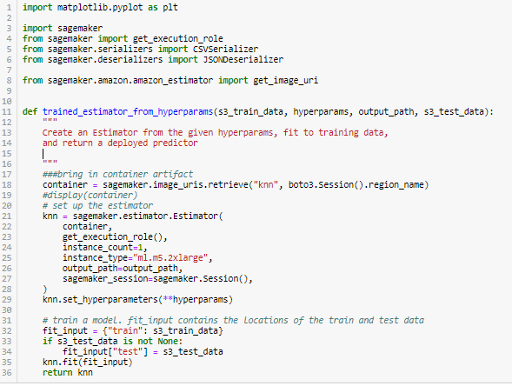
Model KNN
Slightly different approach
Transformed train, test and validation sets into numpy arrays and then converted the numpy arrays into Record.IO file format
Defined function to train a sagemaker.estimator
Key Parameters used
Classifier as predictive type
K – started at 2
Sample Size
Training Results – Completed 192 Seconds
Notes:
A completely managed service; you operate in a dynamic, on-demand mode, with all of the flexibility, agility and scalability of cloud based infrastructure. Presidio ensures RI’s are applied to running instances 100% of the time eliminating waste and maximizing cost reduction.
Eliminates the time and operational overhead associated with usage and RI forecasting, RI type and term analysis, technical risk management, and financial risk and ROI analysis.
Presidio redistributes any/all unused/under-utilized RI’s through our framework, eliminating your burden of selling on the AWS marketplace, tracking transactions, distributing internal credits and associated management.
Enhanced and Customized Billing/Performance optimization reporting
Access to Presidio/AWS Solution Architects
Presidio will provide full access to all reporting data via CloudHealth

Slide 23
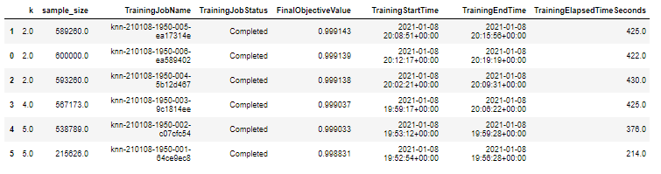
Model KNN - tune
Test Accuracy used to tune the model – 6 Jobs
Tuned on:
K (2,6)
Sample Size (200K, 60K)
Bayesian Strategy
Best Model
K = 2
Sample Size = 589260
Best Model Name = knn-210108-1950-005-ea17314e
Notes:
A completely managed service; you operate in a dynamic, on-demand mode, with all of the flexibility, agility and scalability of cloud based infrastructure. Presidio ensures RI’s are applied to running instances 100% of the time eliminating waste and maximizing cost reduction.
Eliminates the time and operational overhead associated with usage and RI forecasting, RI type and term analysis, technical risk management, and financial risk and ROI analysis.
Presidio redistributes any/all unused/under-utilized RI’s through our framework, eliminating your burden of selling on the AWS marketplace, tracking transactions, distributing internal credits and associated management.
Enhanced and Customized Billing/Performance optimization reporting
Access to Presidio/AWS Solution Architects
Presidio will provide full access to all reporting data via CloudHealth

Slide 24
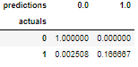
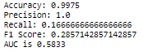
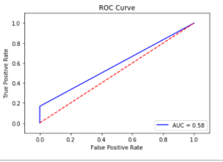
Model KNN – host and eval
Analysis of results used: 1000 Sample Size invoked on Endpoint
Confusion matrix
Accuracy
Precision
Recall
F1 Score
AUC
ROC Curve
Results are mized– 99.75% accuracy and False Negatives are very small .002% however recall is very small and precision is really good
Notes:
A completely managed service; you operate in a dynamic, on-demand mode, with all of the flexibility, agility and scalability of cloud based infrastructure. Presidio ensures RI’s are applied to running instances 100% of the time eliminating waste and maximizing cost reduction.
Eliminates the time and operational overhead associated with usage and RI forecasting, RI type and term analysis, technical risk management, and financial risk and ROI analysis.
Presidio redistributes any/all unused/under-utilized RI’s through our framework, eliminating your burden of selling on the AWS marketplace, tracking transactions, distributing internal credits and associated management.
Enhanced and Customized Billing/Performance optimization reporting
Access to Presidio/AWS Solution Architects
Presidio will provide full access to all reporting data via CloudHealth

Slide 25
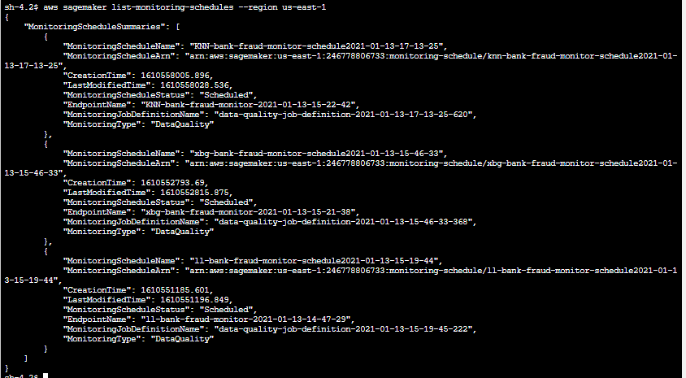
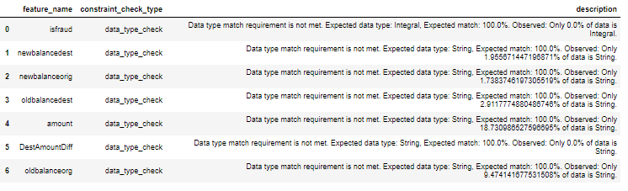
Model Monitoring – Data Quality
Created a data quality monitoring schedule for each model – next steps would be creating a model quality monitor - simple differences are a few parameters such as
Step 1 - set up data capture config and deploy monitor endpoint (results stored in S3)
Step 2 - invoke model to make sure its capturing data based on config
Step 3 – set up baseline reusing training data with header * note had to add .001 to certain columns to fix the spark processing job to infer correct data type.
Step4 – send artificial data to invoke endpoint and list monitoring executions – violation results created , if any
*Example – of violations below when the processing created a constraint file that had certain variables as string instead of numeric.
Notes:
A completely managed service; you operate in a dynamic, on-demand mode, with all of the flexibility, agility and scalability of cloud based infrastructure. Presidio ensures RI’s are applied to running instances 100% of the time eliminating waste and maximizing cost reduction.
Eliminates the time and operational overhead associated with usage and RI forecasting, RI type and term analysis, technical risk management, and financial risk and ROI analysis.
Presidio redistributes any/all unused/under-utilized RI’s through our framework, eliminating your burden of selling on the AWS marketplace, tracking transactions, distributing internal credits and associated management.
Enhanced and Customized Billing/Performance optimization reporting
Access to Presidio/AWS Solution Architects
Presidio will provide full access to all reporting data via CloudHealth

Slide 26
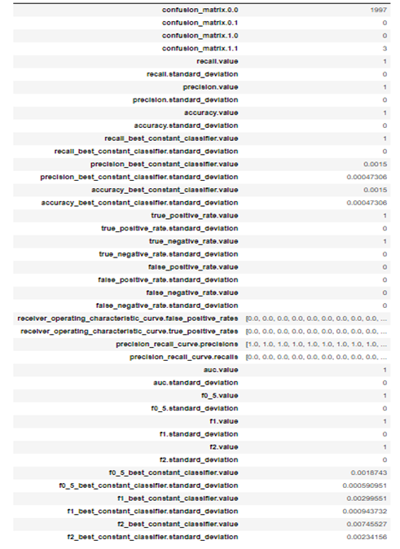
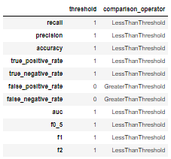
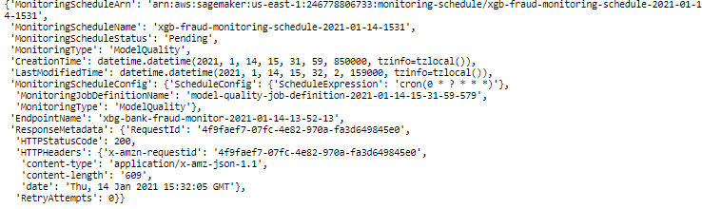
Model Monitoring – Model Quality on XGboost
Xgboost was our best model and the endpoint to keep in production – invoked predictions and appended to testing dataset first to provide an prediction, probability and label dataset to set baseline constraints/metrics
-ModelMonitoringXGBoost-ModelMonitor.ipynb
Binary classification metrics
Binary classification Contraints
Scheduled Created
Notes:
A completely managed service; you operate in a dynamic, on-demand mode, with all of the flexibility, agility and scalability of cloud based infrastructure. Presidio ensures RI’s are applied to running instances 100% of the time eliminating waste and maximizing cost reduction.
Eliminates the time and operational overhead associated with usage and RI forecasting, RI type and term analysis, technical risk management, and financial risk and ROI analysis.
Presidio redistributes any/all unused/under-utilized RI’s through our framework, eliminating your burden of selling on the AWS marketplace, tracking transactions, distributing internal credits and associated management.
Enhanced and Customized Billing/Performance optimization reporting
Access to Presidio/AWS Solution Architects
Presidio will provide full access to all reporting data via CloudHealth

Slide 27
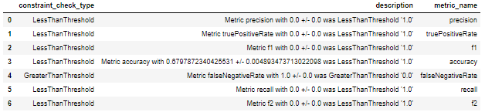
Model Monitoring – Model Quality on XGboost
Steps Taken after Scheduled Created with artificial ground truth data
Examined executions (waited until the hour mark)
Reported any violations
Monitored Cloudwatch metrics
Created Cloudwatch Alarm
Violations from monitoring inspections
Notes:
A completely managed service; you operate in a dynamic, on-demand mode, with all of the flexibility, agility and scalability of cloud based infrastructure. Presidio ensures RI’s are applied to running instances 100% of the time eliminating waste and maximizing cost reduction.
Eliminates the time and operational overhead associated with usage and RI forecasting, RI type and term analysis, technical risk management, and financial risk and ROI analysis.
Presidio redistributes any/all unused/under-utilized RI’s through our framework, eliminating your burden of selling on the AWS marketplace, tracking transactions, distributing internal credits and associated management.
Enhanced and Customized Billing/Performance optimization reporting
Access to Presidio/AWS Solution Architects
Presidio will provide full access to all reporting data via CloudHealth

Slide 28
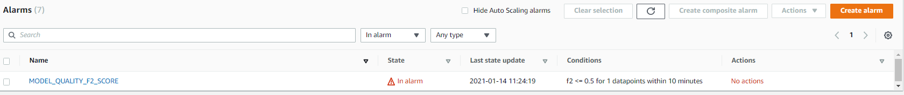
Model Monitoring – Model Quality on Xgboost – Cont.
Steps Taken after Scheduled Created with artificial ground truth data
Examined executions (waited until the hour mark)
Reported any violations
Monitored Cloudwatch metrics
Created Cloudwatch Alarm – set limit low to incur an alarm
CloudWatch Alarm
Notes:
A completely managed service; you operate in a dynamic, on-demand mode, with all of the flexibility, agility and scalability of cloud based infrastructure. Presidio ensures RI’s are applied to running instances 100% of the time eliminating waste and maximizing cost reduction.
Eliminates the time and operational overhead associated with usage and RI forecasting, RI type and term analysis, technical risk management, and financial risk and ROI analysis.
Presidio redistributes any/all unused/under-utilized RI’s through our framework, eliminating your burden of selling on the AWS marketplace, tracking transactions, distributing internal credits and associated management.
Enhanced and Customized Billing/Performance optimization reporting
Access to Presidio/AWS Solution Architects
Presidio will provide full access to all reporting data via CloudHealth

Slide 29
Resources
Github page - https://github.com/mattkorn10/BlackBeltCapstone
Youtube Video -
Notes:
A completely managed service; you operate in a dynamic, on-demand mode, with all of the flexibility, agility and scalability of cloud based infrastructure. Presidio ensures RI’s are applied to running instances 100% of the time eliminating waste and maximizing cost reduction.
Eliminates the time and operational overhead associated with usage and RI forecasting, RI type and term analysis, technical risk management, and financial risk and ROI analysis.
Presidio redistributes any/all unused/under-utilized RI’s through our framework, eliminating your burden of selling on the AWS marketplace, tracking transactions, distributing internal credits and associated management.
Enhanced and Customized Billing/Performance optimization reporting
Access to Presidio/AWS Solution Architects
Presidio will provide full access to all reporting data via CloudHealth

Slide 30
THANK YOU!

